Slide 1




NFO @ FAO’s 80th Anniversary
Introduction
Forestry Division NFO
Notes:
This is the main opening slide. Use it to introduce the topic or the central theme of the presentation.

Slide 2
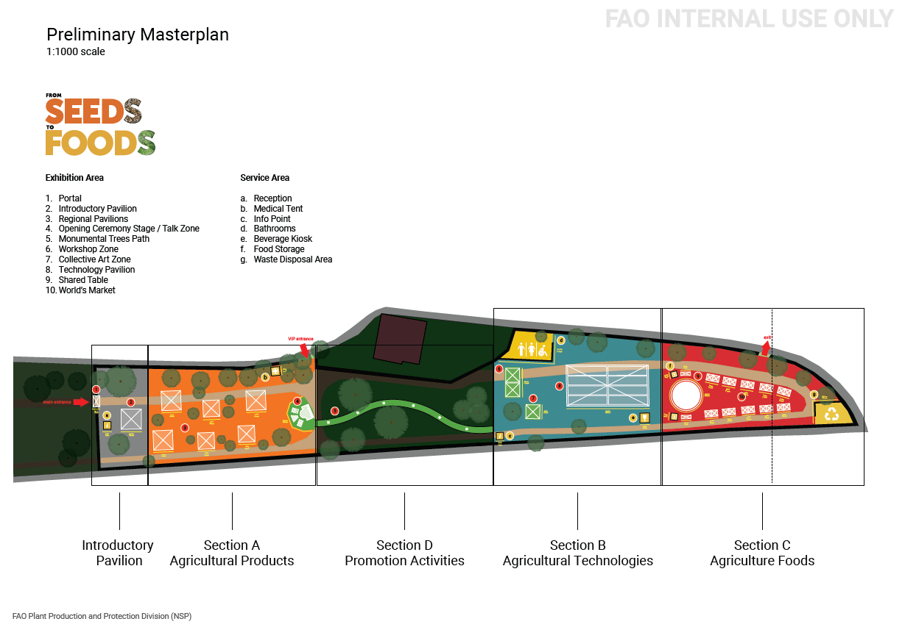
“From Seeds to Foods ” Exhibition
Showcase impactful actions and solutions for the future of global agrifood systems
Present a journey through the entire agrifood system value chain—from seeds to foods
Through the lens of sustainability, resilience, innovation, and inclusion
Masterplan of the Exhibition
Notes:
Youth Engagement: Providing a platform for youth to share perspectives and experiences that drive action in the forestry sector.
Cultural Connection: Celebrating the cultural link between forests and music, fostering creative expressions that connect communities to nature and sustainability.
Contribute to FAO 80th Anniversary: Serve as a thematic milestone in the lead-up to the World Food Forum (WFF) in October 2025 and the XVI World Forestry Congress in 2027 (Peru).

Slide 3
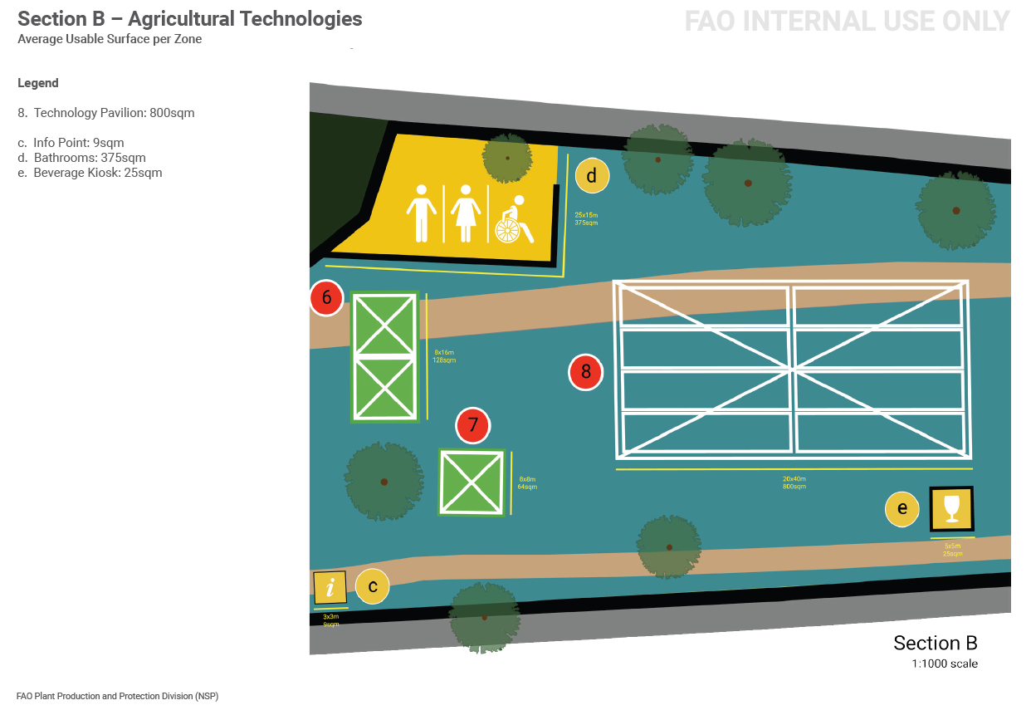
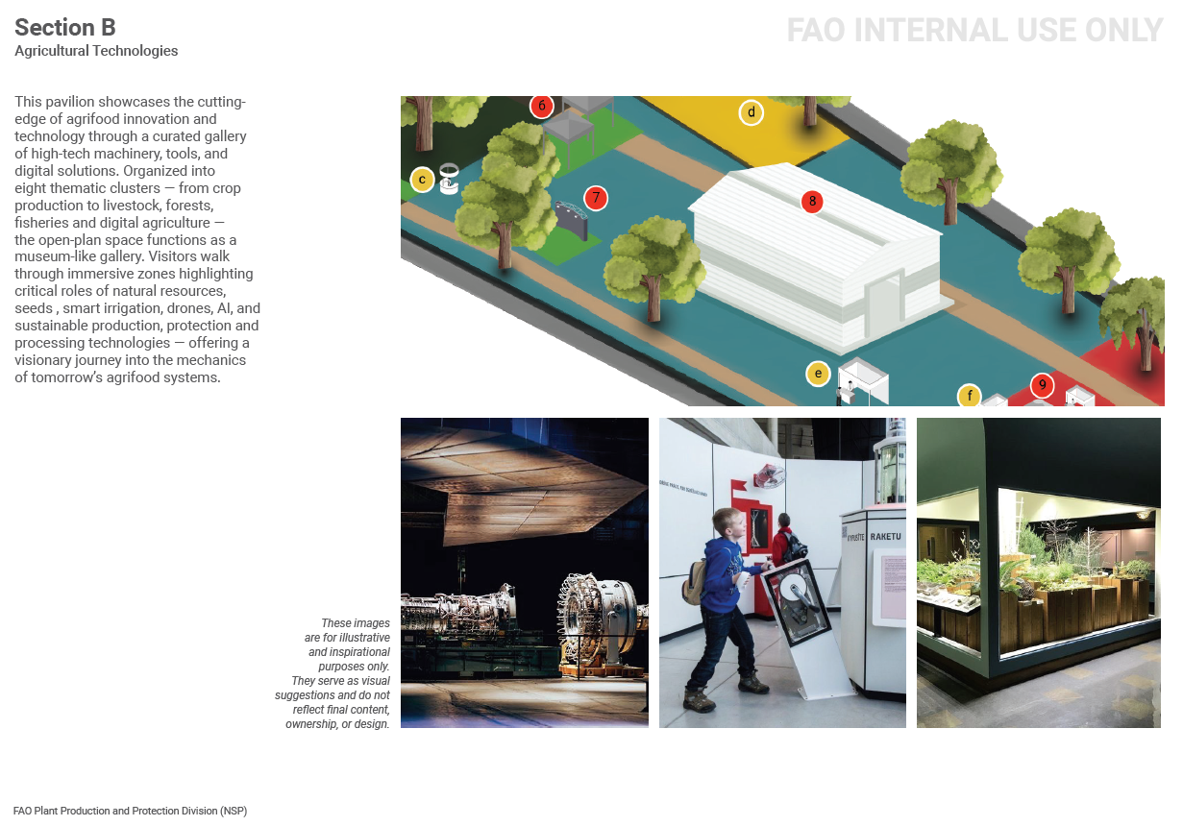
“From Seeds to Foods ” Exhibition
Area for Section B (10 Units)
Total: 1625 sqm
Pavilion: 800sqm
Notes:
Youth Engagement: Providing a platform for youth to share perspectives and experiences that drive action in the forestry sector.
Cultural Connection: Celebrating the cultural link between forests and music, fostering creative expressions that connect communities to nature and sustainability.
Contribute to FAO 80th Anniversary: Serve as a thematic milestone in the lead-up to the World Food Forum (WFF) in October 2025 and the XVI World Forestry Congress in 2027 (Peru).

Slide 4

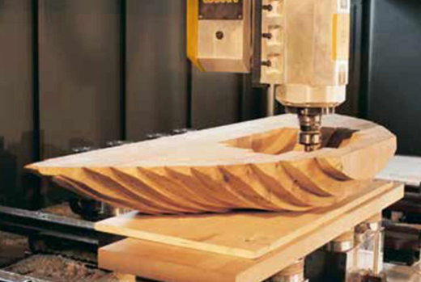


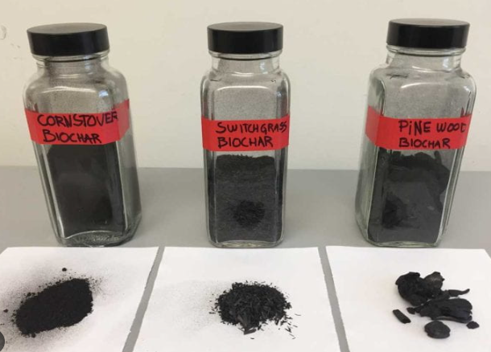
[Add Image]
“From Seeds to Foods ” Exhibition
The final masterplan of the exhibition will be launch on July 10th.
Section B will coordinate with Section D with interactive activities: talks
NFO provided 4 items and 1-2 talks:
Forest machinery: CNC machine for precision wood manufacturing
Innovative Forest Products
Forestry technology: biochar
Talks: From Forest to Farm: Wood Innovations for Agrifood Transformation
Notes:
This slide is designed to combine a list of key points with a prominent vertical image.

Slide 5
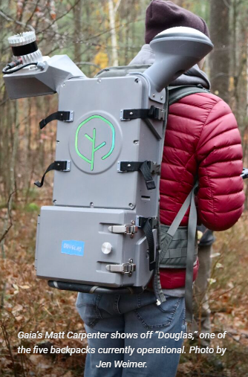
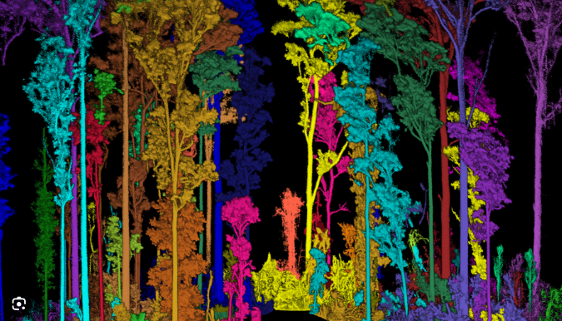
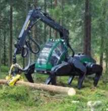
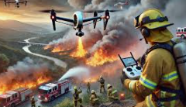
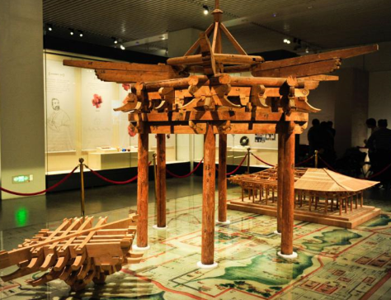
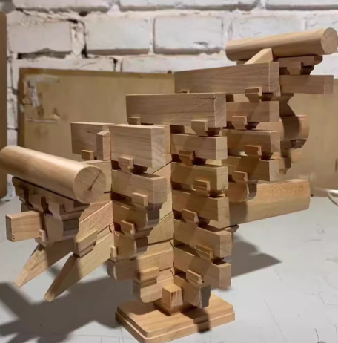
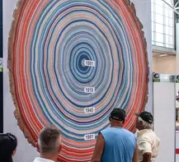
[Add Image]
Technology Area | Innovations/Applications
Digitalization & Data | Remote sensing, GIS, AI, digital twins, sensor networks
Biotechnology & Genetics | Genomic selection, genetic engineering, DNA barcoding, drought-tolerant species
Monitoring & Traceability | Real-time platforms deforestation alerts and land-use change tracking, Radio Frequency Identification(RFID) , blockchain, DNA wood identification
Fire Management | AI-driven detection, drones, integrated fire management, controlled burning
Automation | Robotics, automated harvesters, mobile field tools
Restoration & Ecosystem | Drone reforestation, PES (Payment for Ecosystem Services ) platforms, biodiversity monitoring
Wooden construction | Handcrafted of wooden/bamboo construction
Tree specimen | Tree specimen (model) to show the annual ring
Notes:
This slide is designed to combine a list of key points with a prominent vertical image.

